Slide 1

Municipality of Casselman
Financial System and Process Review
Recommendations Report
Confidential
October 31st 2022,
Updated January 25, 2023

Slide 2
Table of Contents
Introduction
Current State Overview
Future State
Refreshing the Finance Department’s Policies
Technology Assessment
Implementation Plan
Finance Operations Maturity Levels
Change Management
Appendices

Slide 3
Introduction

Slide 4
Project Goal and Objectives
Project Goal
The Municipality of Casselman has engaged MNP to conduct a Financial System and Process Review, which aimed to assist the Municipality in maintaining its financial viability through implemented processes, systems, and polices.
Project Objectives
The Report is intended to provide the Municipality a summary of MNP’s current state observations and to offer recommendations in regards to improvement and optimization opportunities to help the Finance Department become more operationally effective and efficient.
In addition, this Report also provides the Municipality with an Implementation Plan and Change Management best practices that may be used to identify the work that needs to be done, identify quick wins and prioritize further projects, some that may be completed with existing staff and others that may require external support.

Slide 5
Approach and Methodology
MNP drew upon the Current State Report and Recommended Processes to develop a set of implementation principles to guide the development of the future state Casselman process maps and suggested implementation plan.
Building upon these principles, MNP then developed Casselman’s updated processes.
The recommendations report includes:
Summary of opportunities identified in the current state assessment;
Recommended improvement areas and design criteria;
Recommended improved process maps for each key process;
Implementation best practices; and
Technology preliminary recommendations for next step.
Consultations and Workshop
Current State Processes
Opportunities for Improvement
A thorough review of information and data collected along with learnings from best practices and the current state mapping exercise were used to determine opportunities for improvement.
Validation of Future State Design Criteria
The improvement design criteria were verified and validated by the executive team, and will serve as the foundation for the development of the improved (future state) process maps.
Future State Process Recommendations
The Recommendations report provides Casselman with the recommended Finance department processes designed to improve the Municipality’s efficiency and processes

Slide 6
Current State Overview

Slide 7
Overview of the Finance Department
This slide provides an overview of the Finance Department’s current context, including the departmental structure, the team members and their tenure.
CONTEXT
There are currently four members in the Finance Department, as shown in the organizational chart.
  It is noted that the staff within the Finance Department are relatively new in tenure.
The Treasurer is responsible for all approvals for work undertaken by the Senior Accounting Clerk, the Accounts Receivable & Tax Clerk, as well as the Accounting Clerk.
The Finance Department does not currently have any formalized process maps, guidelines, manuals, etc. for the activities it carries out. This results in only those responsible for an activity knowing what, how and when to do it.
Further to this, the Department currently has a significant number of transactions and processes that are paper-based and require manual steps. This creates inefficiencies and may increase the risk of processing delays and misplaced documents.
The Department does not have a document management system (information is not digitized), which may also contribute to the risk mentioned above.
CAO
Yves Morrissette
Finance Department
Treasurer
Simon Thibeault
Senior Accounting Clerk
Lise Labelle
Accounts Receivable & Tax Clerk
Nada Korban
Accounting Clerk
Huguette Cote

Slide 8
Summary of Current State Observations
The following section summarizes MNP’s current state observations and opportunities. The observations provided in this report represent the challenges and/or gaps identified through MNP’s current state assessment. Opportunities have been identified to address these challenges and/or gaps, which will be used to develop future state recommendations. The observations and opportunities have been summarized into six (6) categories, outlined below:
Informal Processes and Procedures
There are currently no established or formal frameworks or standardization for financial processes. It was noted that they are done ‘the way they were always done’. Casselman does not have written guides or manuals to inform new employees on the processes/procedures, which may become a challenge for the Municipality when it comes to its succession planning or cross-training.
Potential Need for Internal Control
The Finance Department seems to have some internal controls in place but may gain efficiency by introducing some earlier in the processes. It was noted that it would be beneficial for Casselman to update or develop more formalized processes that would include additional quality control steps. This ensures standardization, minimizing risks or human errors and allows for higher quality control.
A Lack of Segregation of Duties
Currently, most tasks are completed by one person in one process. This is fairly common in a smaller department, however there could be some benefits to looking into some of these processes with that in mind. There is an opportunity to segregate duties and incorporate additional measures to ultimately ensure better quality control.
An Abundance of Manual Steps
A key theme that currently affects all the processes MNP mapped is the abundance of manual steps in each process. This includes time spent manually entering data, which then needs to be entered into VADIM, as well as going to the bank in person to deposit cheques, etc.
A Need for Digitization
During the process mapping sessions, it was noted that Casselman prints and keeps most of its records and documentation in paper format. There is no easy access to the information unless an employee already knows where the information is stored/archived (i.e., numerous Excel documents).
Outdated and Not Enforced Policies
The Finance Department has a number of policies (procurement, thresholds, credit cards). However, these policies are either outdated or not currently referred to/enforced. It was mentioned that the Procurement Policy for one may need to be reviewed and updated to suit the needs of the Municipality.

Slide 9
Future State

Slide 10




Establishing the Future State Design Criteria
Based on the current state key themes, the following design criteria have been validated by the Casselman Project Team during the Future State Workshop #1
Ensure Formal Processes & Procedures are Implemented and Enforced
Ensure that recommendations are formalized and are built in such a way that they can be successfully enforced within the Municipality.
Ensure Internal Controls are Implemented Where Needed
Ensure that recommendations assign additional internal controls (i.e., additional review and approval procedures, segregation of duties, etc.) where needed.
Consider Opportunities for Modernization - Automation and Digitization
Ensure that recommendations achieve efficiencies by improving processes through increased automation and digitization.
Ensure Processes are Aligned with Financial Policies
Ensure that recommendations regarding the Finance Department’s processes are aligned with the Municipality’s financial policies (old and new).

Slide 11
Future State Process Recommendations

Slide 12



Future State Process Recommendations (1/2)
Building on the observations and opportunities identified in the Report, MNP developed six (6) recommendations for the Finance Department to consider. The recommendations are the result of highlighted opportunities discovered during the current state assessment and are reinforced by the insights provided during the future state workshop.
Modernization - Automation and Digitization
Transitioning to a digital document system could eliminate the manual steps required to print and file documents and significantly reduce the amount of misplaced documentation, protecting the Department from potential audit risks. In addition, utilizing the organization’s shared secured systems (SharePoint) is key to eliminating document’s physical integrity and security risks. When dealing with external data storage devices (e.g., USB), a password is needed to prevent any unwanted access. As a first step towards digitization, the approval processes will need to happen minimally via email.
Furthermore, a new software or system could potentially be implemented to replace the traditional punch cards and processes for the payroll process.
1
3
Proper Use of Internal Controls
Additional internal control steps are recommended for the following processes:
The taxation (revenue) process needs updated approval procedures;
The water & sewers process needs an additional step to inform the CAO of the year’s forecasted taxation revenues outlook and/or changes;
Segregation of authority is necessary for the purchase process, accounts payable process, year-end process, and recreation process.
2
Formal Processes & Procedures for Budget Process
Department managers need to be included in the budget creation process to facilitate their professional accountability and input. All budgets need to be revised at least once a year and transformed into a current year forecast. Department managers need to be informed of budgetary changes/constraints following discussions with Council and final budgeting. They will then be accountable to maintain a healthy budget throughout the year.

Slide 13



Future State Process Recommendations (2/2)
Centralizing Accounting, Reporting, and Reducing Manual Tasks
Elimination of double-entries, multiple systems for accounting (i.e., avoid the registration of payments in Booking, the Booking app should only be used for contract and invoice management), e-transfer payments, physical checks, and the usage of mailing services. In addition, end-of-month reporting should be required for the Recreation team.
5
6
4
Standardization of activities
Pre-approved standard contract specifications will reduce workloads resulting from manual reviews, while also improving processing times. Implementation of standard communication protocols is necessary to further facilitate the transmission and sharing of documents.
Training and Implementation
Staggered implementation is critical to ensure staff members are properly trained and familiar with the new processes. A culture of continuous improvement should be implemented as the application of these processes are underway. Team-training activities are beneficial in the event of any employee departure. More details can be found in later sections.

Slide 14
Budget Process

Slide 15
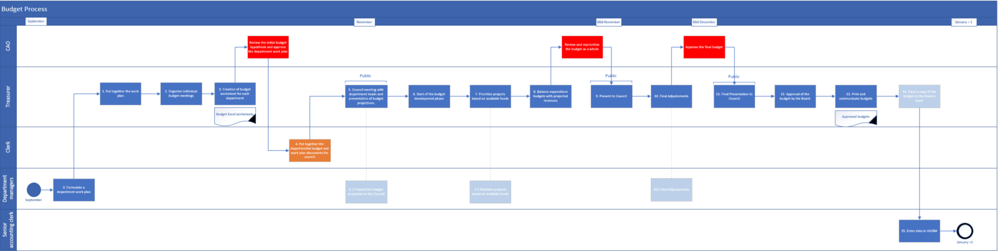
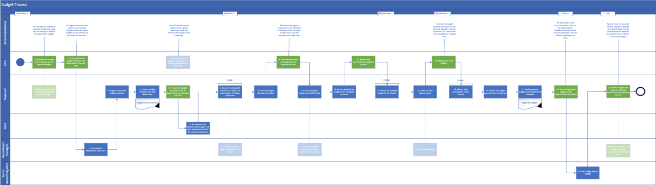
Budget Process
Transitioning away from the Current State
Process Pain Points & Opportunities
Current State Process Map
Lack of formalized processes with quality control steps.
Opportunities:
  An evaluation is needed to evaluate predictions made and the director's abilities to respect their budget.
  Priorities from Council need to be communicated to all department managers to align them with the organization’s objectives as they work on their dept budget.
  The CAO elaborates the organization’s global objectives based on Council priorities, while the treasurer formulates them financially.
  For a healthy budget process, the treasurer will have the freedom of work, while the CAO should only review budgets on a higher level.
  Results must be reviewed at least once per calendar year and all departments should create an adjusted forecast for the remainder of the current year.
  All documents must circulate and be saved in the organization’s SharePoint and approvals must happen either with an official workflow or via email.
Future State Modifications Process Map

Slide 16
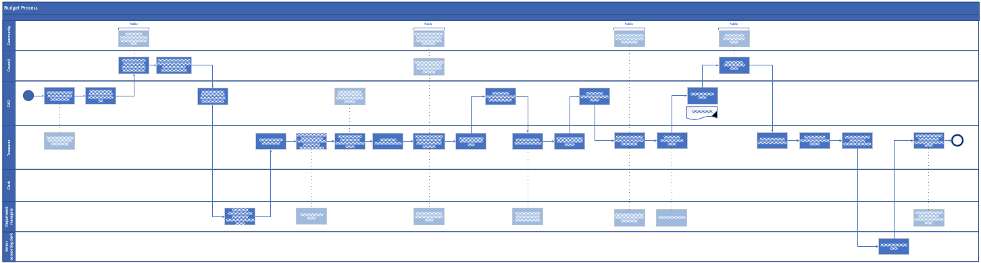
Budget Process
Future State Process Recommendation
Future State Process Map

Slide 17
Accounts Receivable

Slide 18
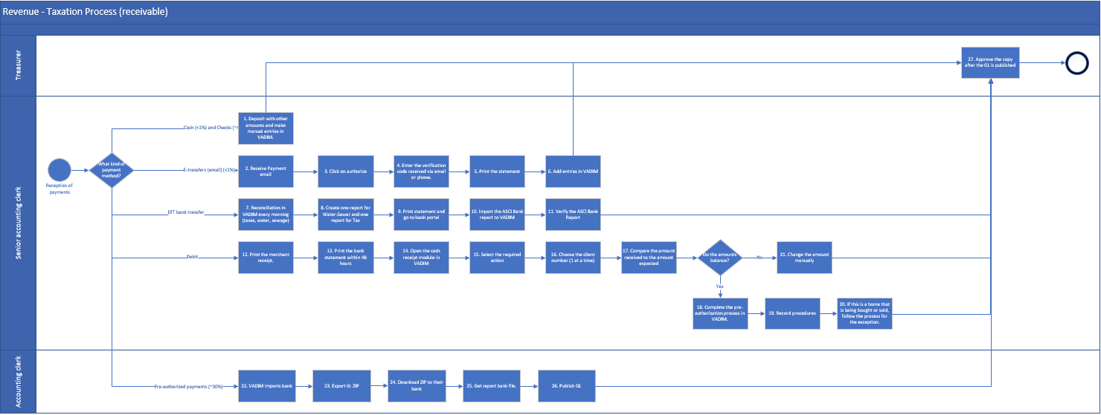
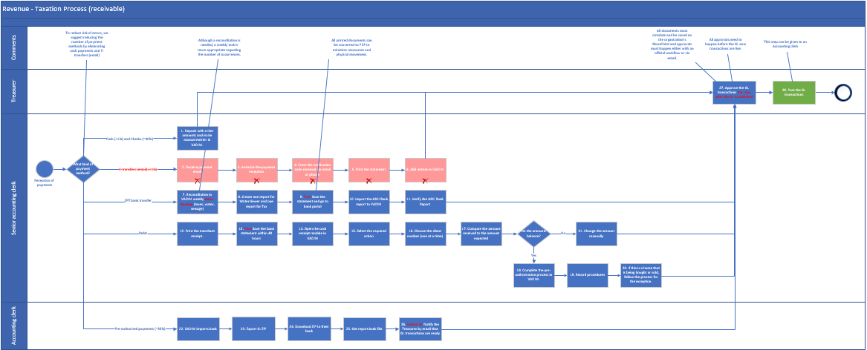
Taxation (Revenue) Process
Transitioning away from the Current State
Current State Process Map
Process Pain Points & Opportunities
Less than 2% of total payments are made up of cash payments and E-transfers, but a separate process is currently required for E-transfer payments. Opportunity: To reduce risk of errors, we suggest eliminating the cash and E-transfer (email) methods.
Reconciliation is done every morning. Opportunity: Although this task is necessary, weekly reconciliation is sufficient.
Documentation is managed in hard-copy. Opportunity: All printed documents can be converted to PDF to minimize resources and physical movement and be saved in SharePoint.
Transaction copies are approved after the GL is published. Opportunity: All approvals need to happen either with an official workflow or via email before the GL transactions are live. GL transactions can be posted by an Accounting clerk. Additionally, all documents must circulate and be saved in SharePoint.
Future State Modifications Process Map

Slide 19
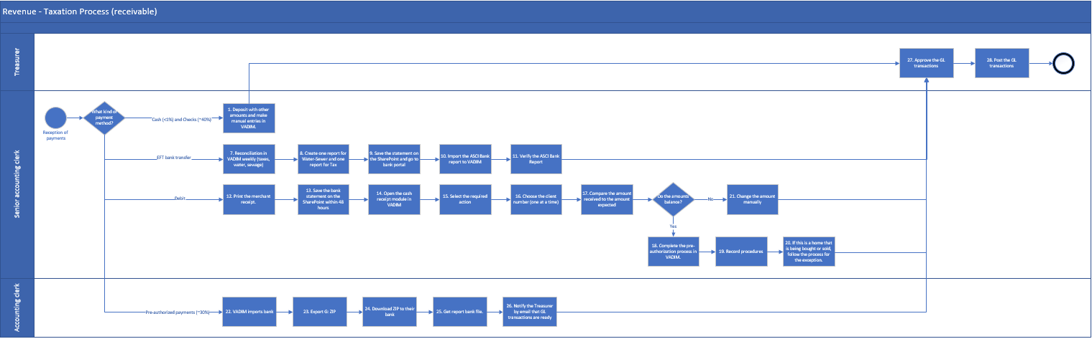
Taxation (Revenue) Process
Future State Process Recommendation
Future State Process Map
Efficiencies and cost savings
Streamlined payment methods: Elimination of email transfers =
75 payments x (0.5 hours x 40$ hourly salary) x 2 (twice per year) = Estimated Economy of $1,500

Slide 20
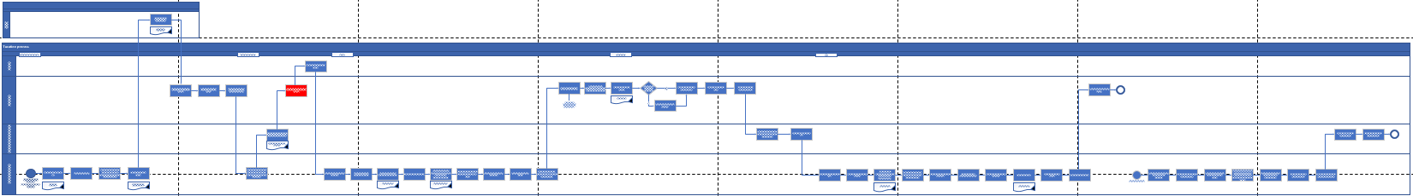
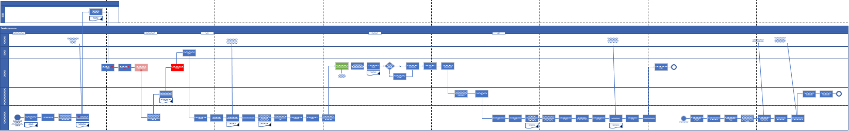
Taxation Process
Transitioning away from the Current State
Process Pain Points &
Opportunities
Current State Process Map
Documentation is managed in hard-copy. Opportunity: Printed reports can be converted to PDF and saved in SharePoint.
Currently, paper invoices are sent to customers directly, which use up resources and are potentially hard to trace. Opportunity: We suggest the implementation of online billing to minimize the mentioned risks.
Opportunity: A digital registry should replace physical indexes.
Future State Modifications Process Map

Slide 21
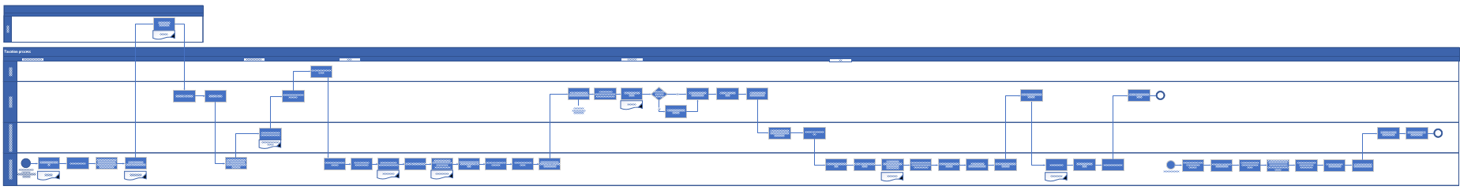
Taxation Process
Future State Process Recommendation
Future State Process Map

Slide 22
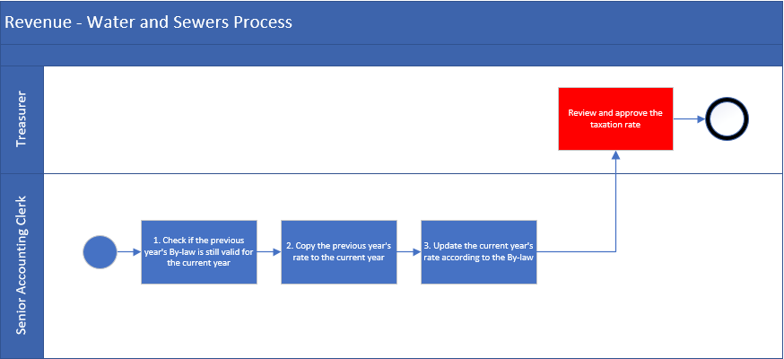
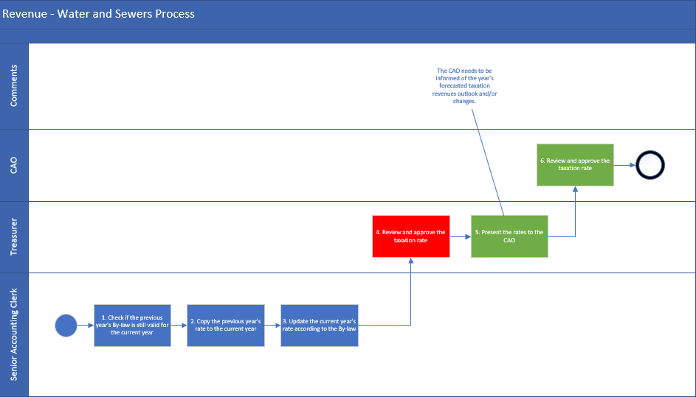
Water and Sewers Process (Yearly)
Transitioning away from the Current State
Current State Process Map
Process Pain Points & Opportunities
Opportunity: The CAO needs to be informed of the year’s forecasted taxation revenues outlook and/or changes.
Future State Modifications Process Map

Slide 23
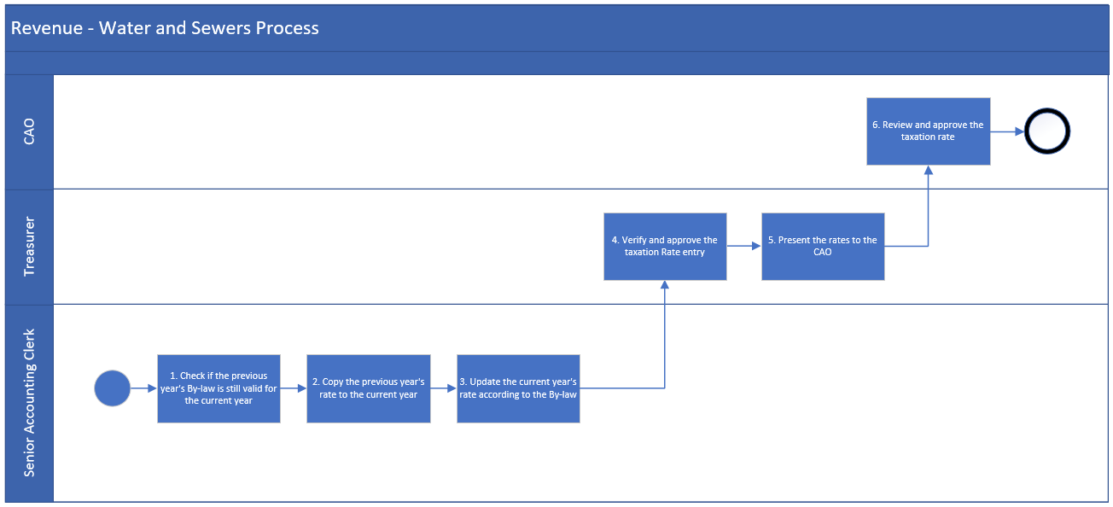
Water and Sewers Process (Yearly)
Future State Process Recommendation
Future State Process Map

Slide 24
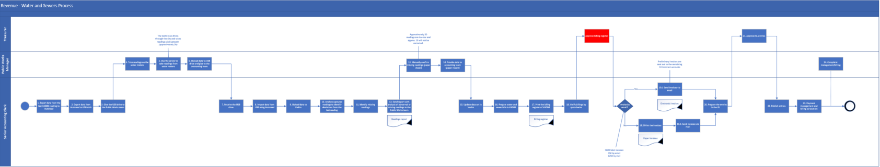
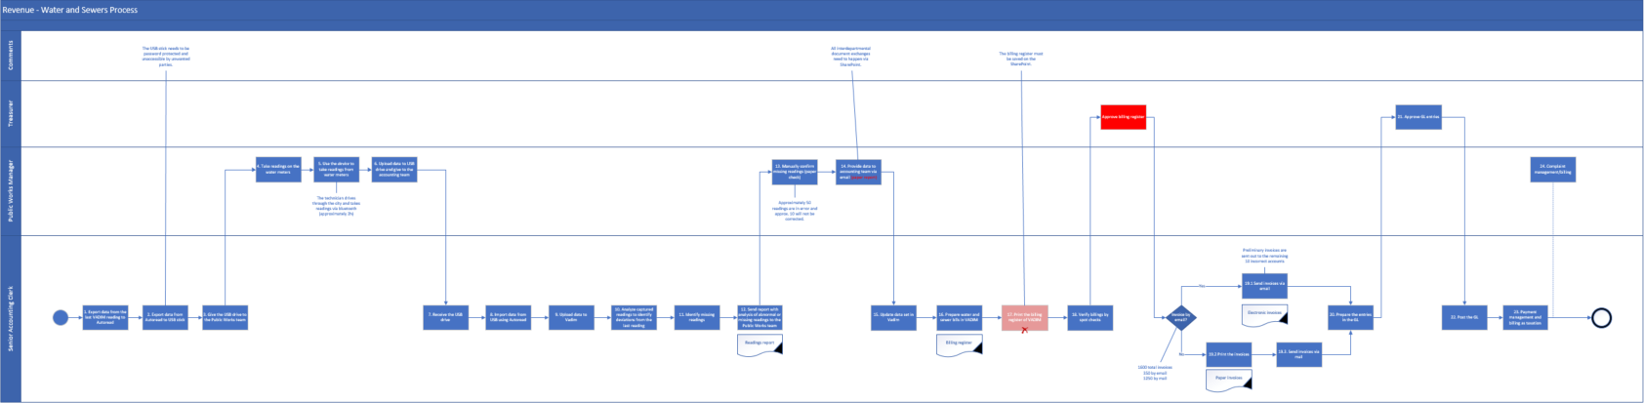
Water and Sewers Process (Quarterly)
Transitioning away from the Current State
Current State Process Map
Process Pain Points &
Opportunities
As data is being exported from Autoread to a USB, the USB needs to be protected with a password to prevent unwanted access.
The accounting team is provided with paper reports. Opportunity: We suggest that all interdepartmental document exchanges happen via SharePoint.
Opportunity: The billing register must also be saved in SharePoint.
Future State Modifications Process Map

Slide 25
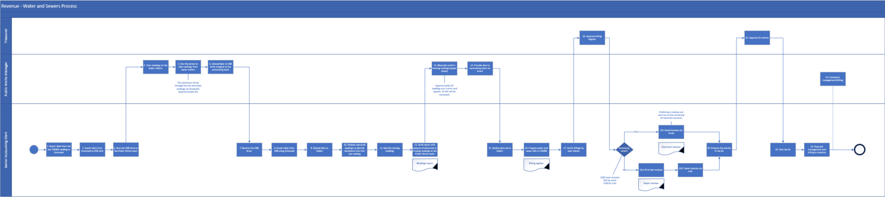
Water and Sewers Process (Quarterly)
Future State Process Recommendation
Future State Process Map

Slide 26
Accounts Payable

Slide 27
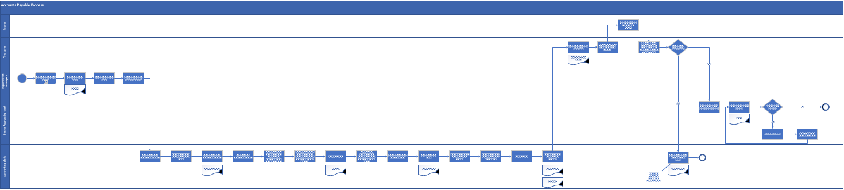
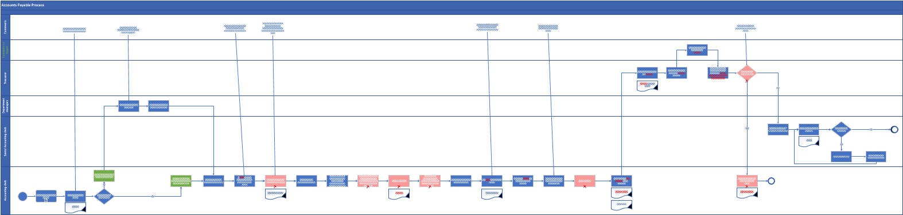
Accounts Payable Process
Transitioning away from the Current State
Current State Process Map
Process Pain Points &
Opportunities
Currently, only one person is working with the suppliers and also receiving the invoices. Opportunity: Invoices must be addressed to the Accounts payable team.
Opportunity: All approvals need to happen electronically and respect the SLA.
Documentation is managed in hard-copy. Opportunity: Printed reports can be converted to PDF and saved in SharePoint.
The current process allows for cheque payments, and the cheques can be sent by post. Opportunity: We suggest removing cheque payments and post usage altogether to save costs and resources.
Opportunity: GL transactions must be approved before being posted.
Future State Modifications Process Map

Slide 28
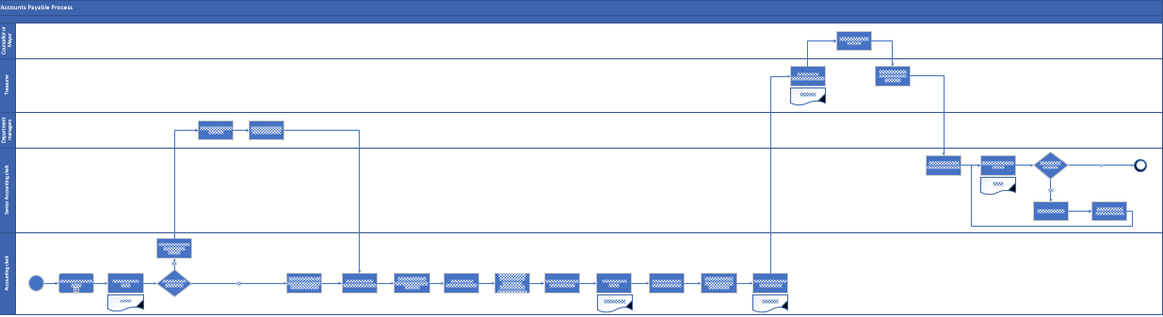
Accounts Payable Process
Future State Process Recommendation
Future State Process Map
Efficiencies and cost savings
Process optimization: Elimination of paper binders =
15,000 pages x ($0.01 ink + $0.015 paper) + (2 hours x $40 hourly salary x 25 binders) = Estimated Economy of $2,375/year
Streamlined payment methods: Elimination of cheque payments =
850 cheques x (0.083 hours x $40 hourly salary) * 70% conversion rate = Estimated Economy of $1,975/year
Streamlined payment methods: Elimination of cheque payments =
850 cheques x ($0.92/stamp x $0.09/envelope) * 70% conversion rate = Estimated Economy of $600/year

Slide 29
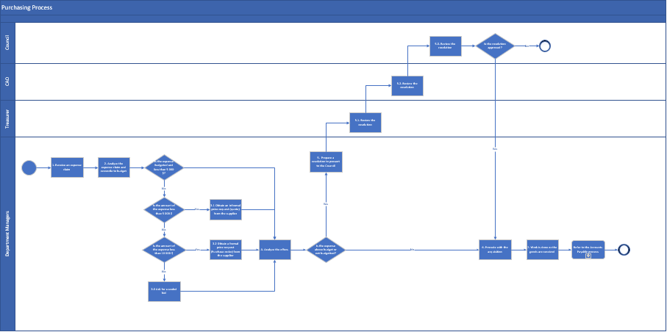
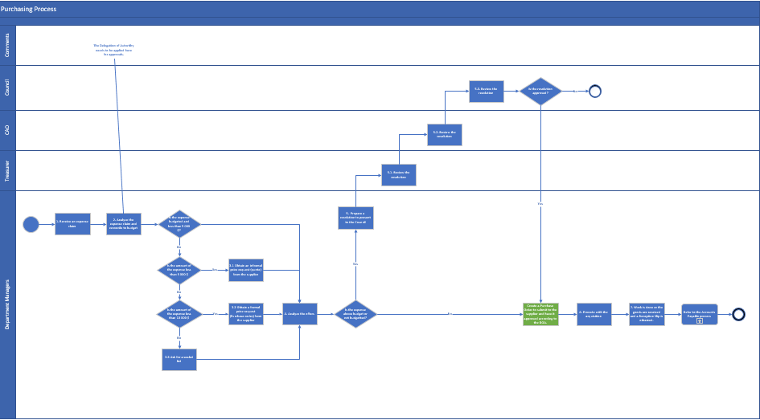
Purchasing Process
Transitioning away from the Current State
Current State Process Map
Process Pain Points &
Opportunities
The Department Managers analyze the expense claims and reconcile them to the budget. Opportunity: The Delegation of Authority needs to be applied for approvals.
Future State Modifications Process Map

Slide 30
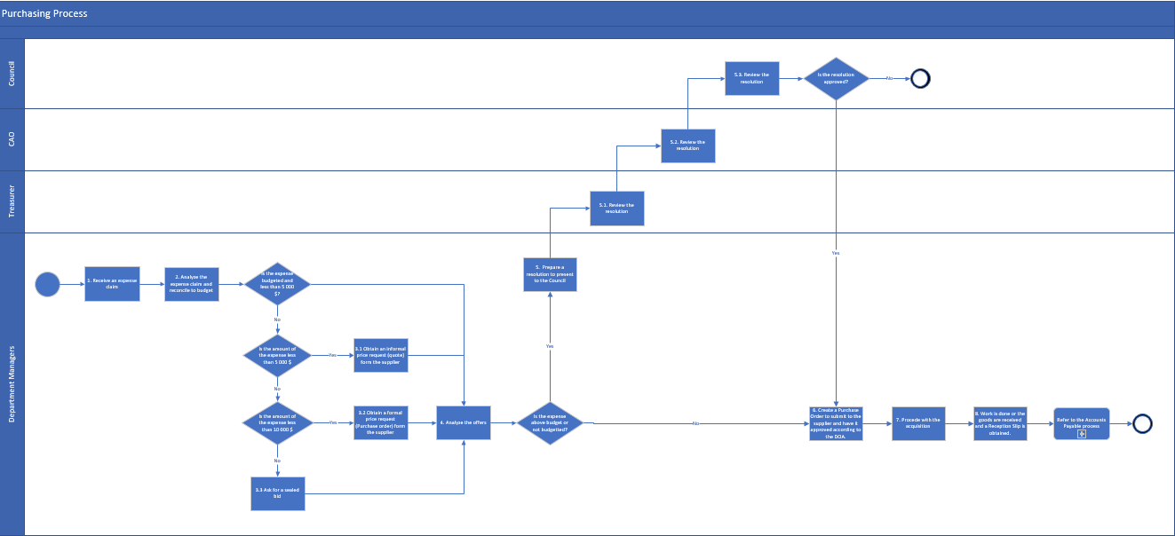
Purchasing Process
Future State Process Recommendation
Future State Process Map

Slide 31
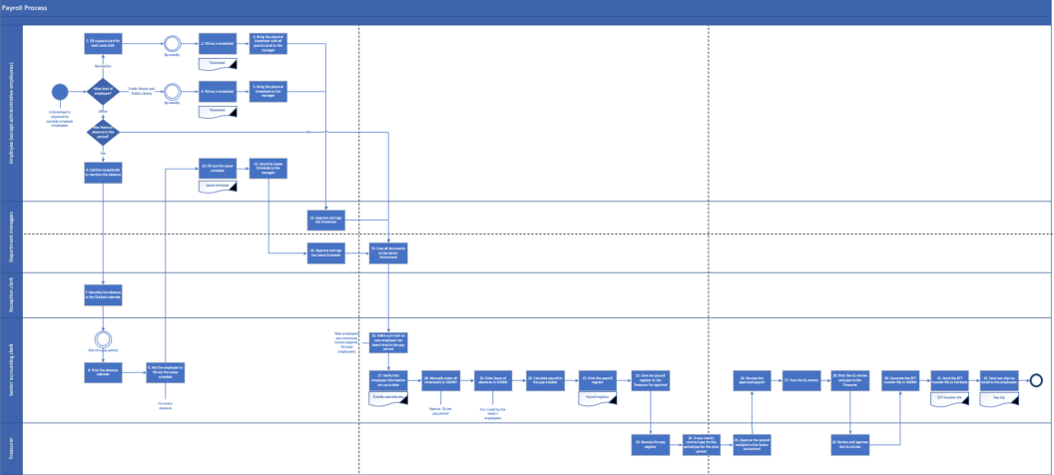
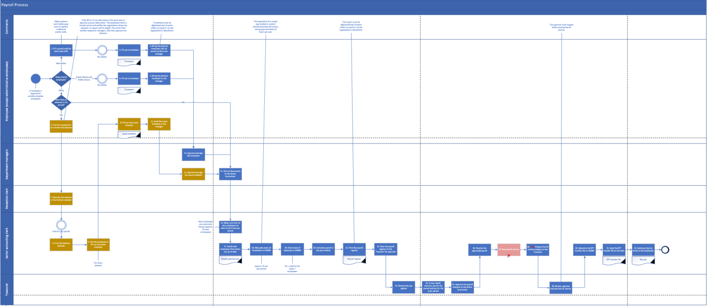
Payroll Process
Transitioning away from the Current State
Current State Process Map
Process Pain Points & Opportunities
Employees fill a punch-card for each work shift. Opportunity: Traditional punch cards can be replaced with systems or mobile apps.
Employees need to go through many steps and different levels/departments to notify the organization of their absence from work. Opportunity: The employee can enter a remote portal and notify the organization about the absence, including reason and length. This action then notifies respective managers, who then approve the absence.
Currently, employees bring the physical timesheet with all punch cards to the manager. Opportunity: Timesheets must be digitized and circulate either by email or via the organization’s SharePoint.
Timesheets are entered manually which take approximately 2 hours per pay period. Opportunity: A system should automate this task, saving approximately 52 hours per year.
Opportunity: Payroll register must be digitalized and circulate either by email or via the SharePoint.
Opportunity: The approval must happen before posting the GL entries.
Future State Modifications Process Map

Slide 32
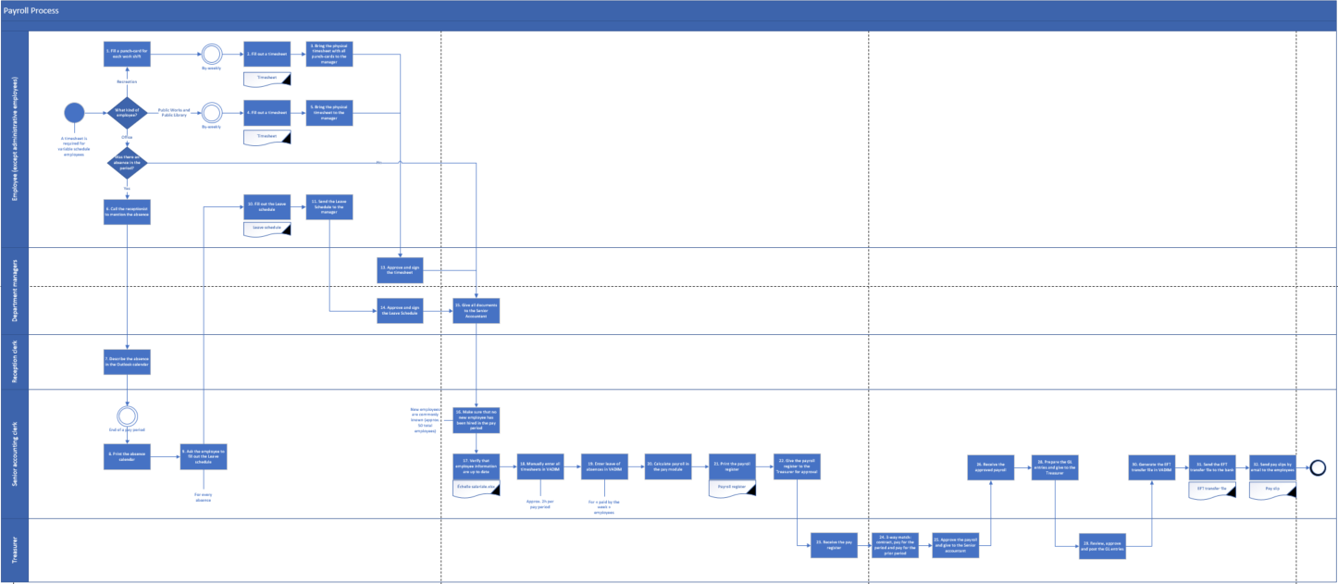
Payroll Process
Future State Process Recommendation
Future State Process Map

Slide 33
Accounting and Reporting

Slide 34
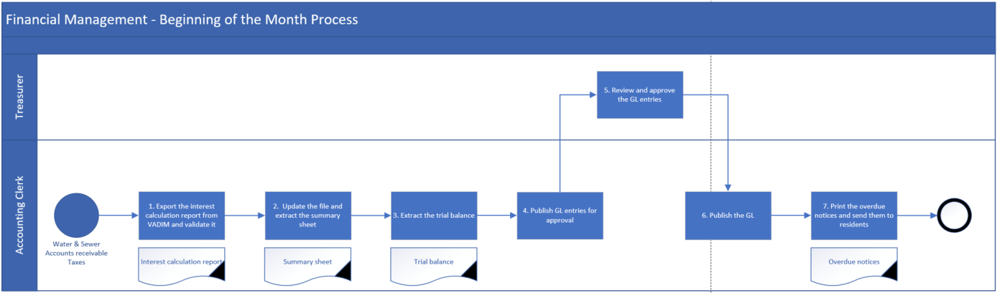
Beginning of the month Process
Future State Process Recommendation
Future State Process Map

Slide 35
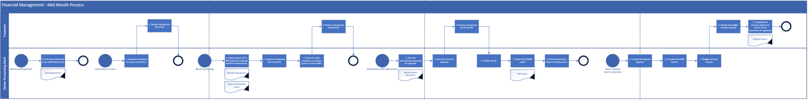
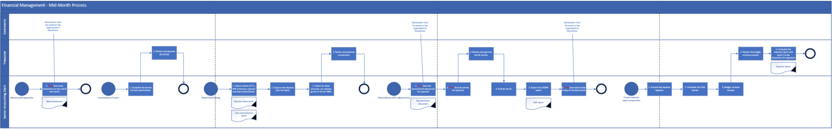
Mid-Month Process
Transitioning away from the Current State
Process Pain Points &
Opportunities
Current State Process Map
Documentation is managed in hard-copy. Opportunity: Printed reports can be converted to PDF and saved in SharePoint.
Future State Modifications Process Map

Slide 36

Mid-Month Process
Future State Process Recommendation
Future State Process Map

Slide 37
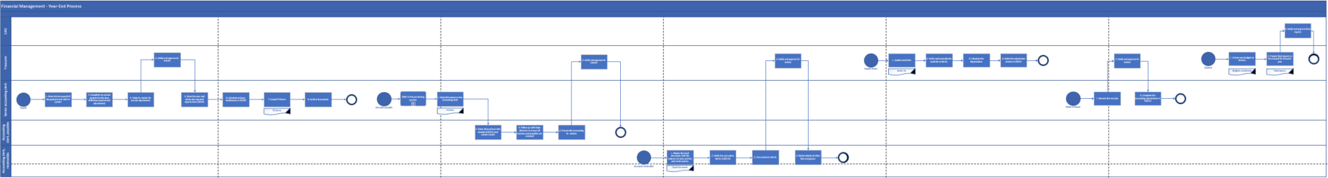
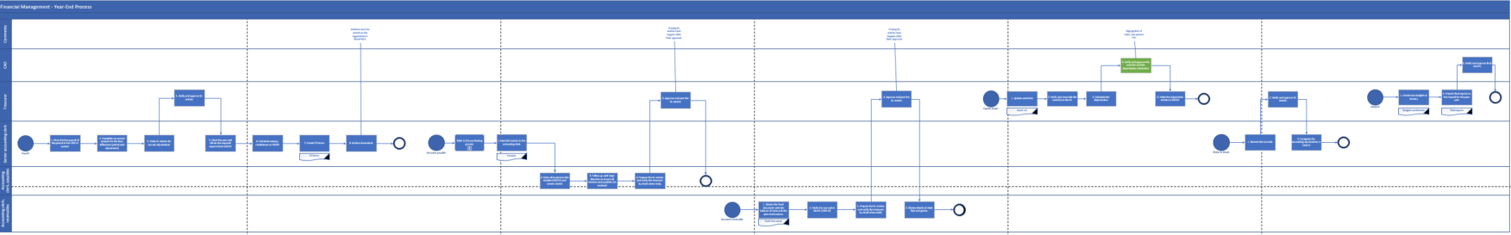
Year-end Process
Transitioning away from the Current State
Current State Process Map
Process Pain Points &
Opportunities
Archived documents are stored physically. Opportunity: Archived documents must be stored on the SharePoint.
Currently, the GL entries are not posted after approval. Opportunity: Posting GL entries must happen immediately after approval.
Opportunity: Segregation of tasks: one person needs to approve the depreciation calculation.
Future State Modifications Process Map

Slide 38
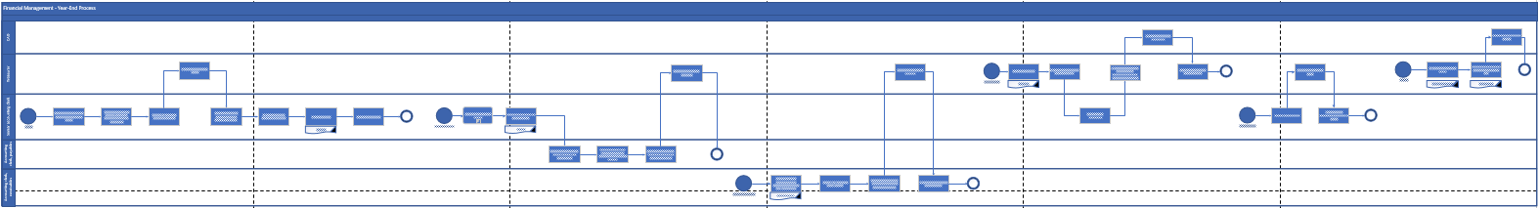
Year-end Process
Future State Process Recommendation
Future State Process Map

Slide 39
Other Revenues

Slide 40
Recreation Process
Current State Analysis
Process Pain Points & Opportunities
Current State Process Map
Lack of a standardized contract. Opportunity: Pre-approved standard contract specifications will enable reductions in the number of approvals required throughout the process, promoting automated and efficient workflows.
Documentation is managed in hard-copy. Opportunity: Attachment of rental contracts with room and/or ice rental invoices must happen via the organization’s SharePoint, supporting centralized record-keeping.
Opportunity : Manual approvals will only be required for contracts that differ from pre-approved standard specifications, reducing processing times and workload for the Director of Recreation.
Currently, payments are registered in Booking. Opportunity :The Booking app would only be used for contracts and invoice management, while manual entries for deposits in VADIM would still be required to connect the two.
The current process requires the Department to take the arena deposit to the bank. Opportunity: A transition to digital payments will improve record-keeping capabilities, while also reducing time requirements from physical deliveries and pickups of funds.
Opportunity: The implementation and optimization of an Excel spreadsheet will allow for customized data tracking and visualization, which also helping to minimize double-entries, manual tasks, and input errors.
Lack of end-of-month reporting. Opportunity: End-of-month reporting by the Recreation team will be required for all payments received and to-be-received, for review by the Treasurer, to ensure updated tracking.
Future State Modifications Process Map

Slide 41
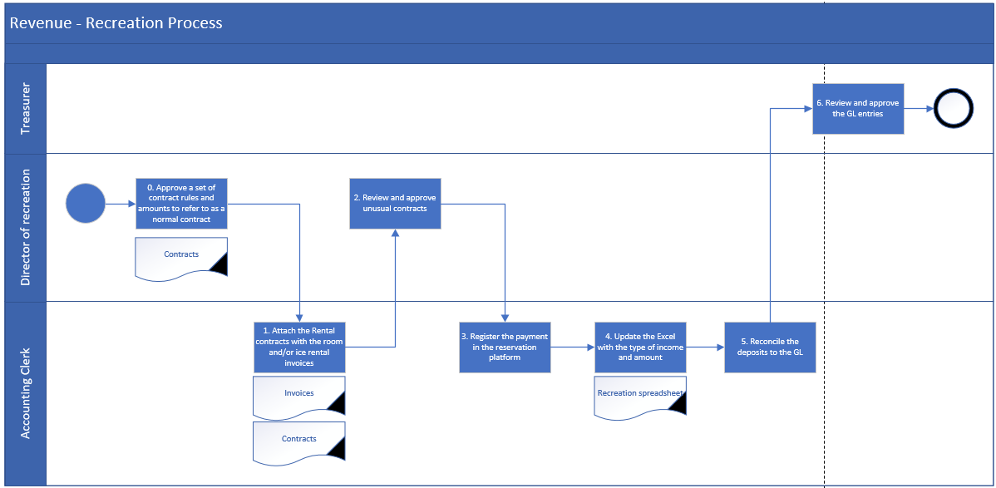
Recreation Process
Future State Process & Recommendations

Slide 42
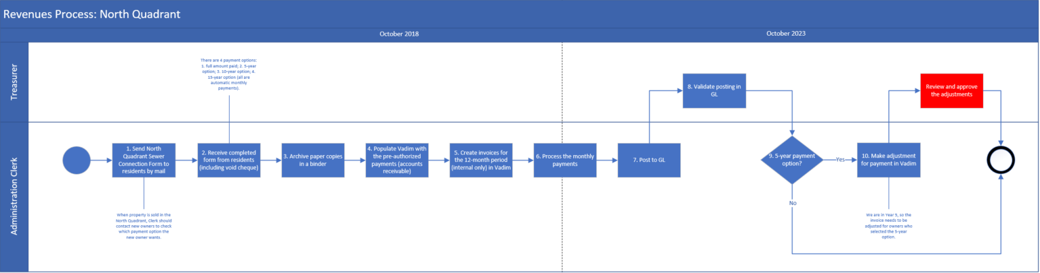
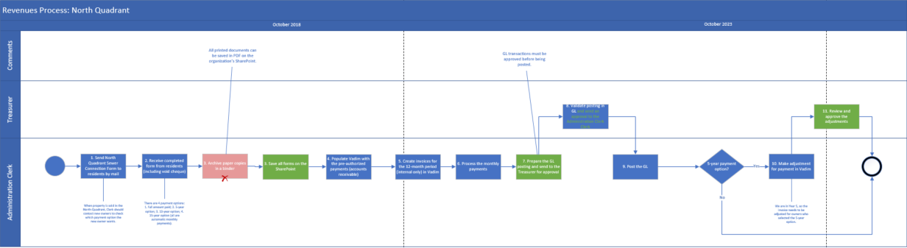
North Quadrant Process
Transitioning away from the Current State
Current State Process Map
Process Pain Points &
Opportunities
Documentation is managed in hard-copy. Opportunity: Printed reports can be converted to PDF and saved on the SharePoint.
Opportunity: GL transactions must be approved before being posted.
Future State Modifications Process Map

Slide 43
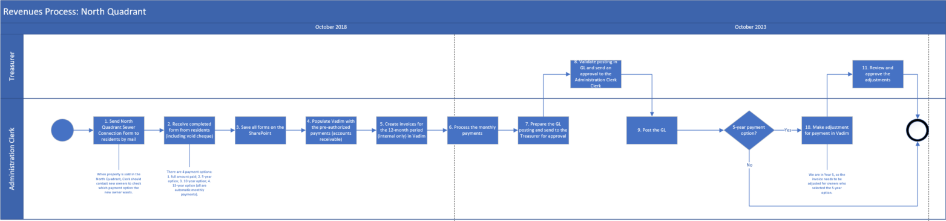
North Quadrant Process
Future State Process Recommendation
Future State Process Map

Slide 44
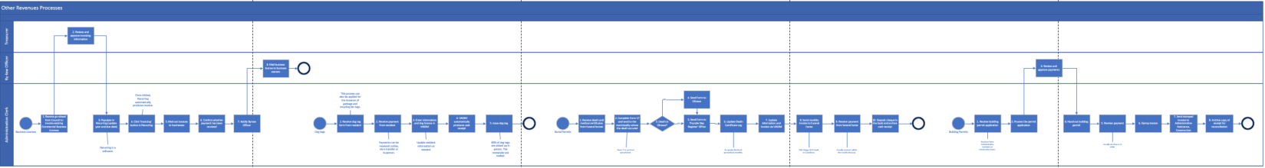
Other Revenues Process
Future State Process Recommendation
Future State Process Map

Slide 45
Refreshing the Finance Department’s Policies

Slide 46




List of Current Policies
Below is a list of the current policies the Finance Department has shared with the MNP team. MNP has recommended the following amendments to the policies.
Policy Name | Date of Policy | Ease of Application / Other Issues? | Prioritization
Politique Achat (F1) | 2005 | To update | 1b
Purchasing Procedures (F2) - ENG | 2005
Procedures Achat (F2) | 2005
Politique de Placement (F3) | 2005 | To update | 1a
Politique Depense (F4) | 2007
Politique sur l’Utilisation des Cartes de Credits (F5) | N/A
Thresholds (F7) | 2015
Asset Amortization (F8) | 2015
Strategic Asset (F9) | 2019
Reserves and Reserve Funds Policy
01
Segregation of Approval
What should change?
02
03
Procurement Policy Thresholds
04
Surplus Allocation

Slide 47
Technology Assessment

Slide 48

Preliminary Technology Recommendation
There is a strong appetite for the Municipality to reinforce the use of technology. Understanding where the Finance Department's strengths and gaps are, as well as a holistic view of all departments within the Municipality, and reinforcing the use of technology where those gaps exist may reduce human error, improve controls and access to data as well as reduce labour intensive tasks within business processes. This would better prepare the Municipality to facilitate efficiencies and optimal use of resource time.
Complete a Technology Assessment
To identify gaps and opportunities, holistically across the organization, and across dimensions of people, process, technology and governance; right-sized and aligned to your key objectives. Understanding where and how to optimize IT spend and investments sets a strong foundation for operational efficiency, to meet current and future needs.
1

Slide 49
Preliminary Technology Recommendations – Key Initiatives
Based on stakeholder discussions, and aligned with overall findings, the following high-level recommendations denote key short-to-medium term initiatives to establish foundation going forward.
Recommendations- Key Initiatives | Rationale | Benefit (H/M/L) | Effort (H/M/L) | Est. Cost | Considerations
Digital Strategy Roadmap | Improved visibility of holistic/strategic/right-sized digital needs across people, process, technology, governance over short-to-long term Determine the What and the Why (i.e. “What” decisions need to be made; “Why” those decisions are the right ones) | H | M | $$$+ | Recommendations can/should be right-sized to organizational context (i.e. size, budget, complexity, etc.) May be opportunity to share various services with surrounding municipalities, where appropriate (i.e. may require further exploration for shared services with other entities)
Validate Finance Solution | Validate existing finance solution can continue to meet both current and future needs/capabilities Determine go forward plan to address gaps, risks, considerations toward a future-state | H | M | $$$ | Align with Digital Strategy Roadmap (i.e. across broader recommendations) Final recommendation may involve replacing existing finance solution (i.e. material cost implication; alignment with longer-term organizational objectives)
Legend
Benefit/Effort
L-Low
M-Medium
H-High
Est. cost Scale
$
$$
$$$
$$$$
< $5K
< $5K - 25K
< $25 - 50K
$50 - 100K

Slide 50
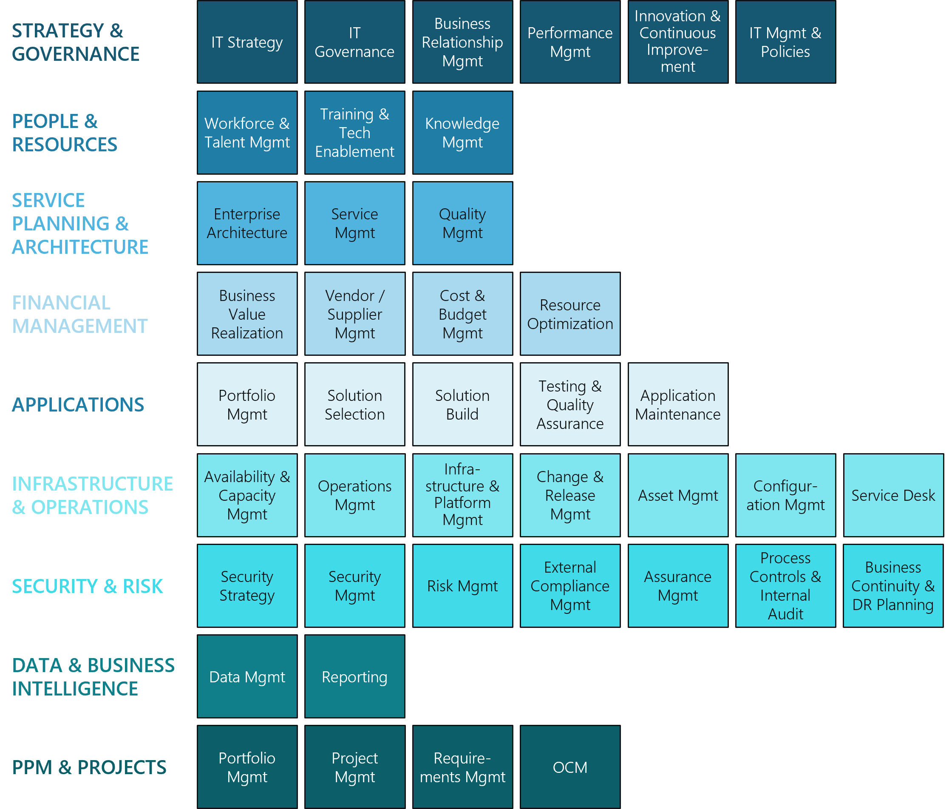
MNP’s Digital Capability Model
The following provides the underlying framework around which we assess, consider and right-size your Digital Maturity to your unique context.
Within the parameters of People, Process, and Technology, MNP's Digital Strategy framework examines the full spectrum of digital capabilities - from strategy and governance through infrastructure and operations all the way to data and business intelligence, that may apply across a particular client context.
While each digital capability is important, some will be more critical than others when assessed within the context of an organization's strategy. Evaluating digital capabilities within this lens is essential to developing a digital strategy that is properly aligned to organizational priorities and can drive the creation of value immediately upon starting to implement.
As an organization looks to modernize and mature, it is important to understand how well your digital strategy aligns with your organizational objectives; helping you optimize and extract the most value, from your IT spend and investments, thereby setting the foundation upon which your organization may thrive.

Slide 51
Implementation Plan

Slide 52
Project Implementation Governance
A strong and clear project governance is necessary to ensure that the project will have a successful outcome. The table below outlines the various project roles and responsible functions. The arrows represent reporting paths, depicting a team that has open communication and strong collaboration.
Role | Members | Functions
Executive Sponsor (CAO) |  | Executive Sponsor
Steering Committee |  | Leadership Support Decision Making Implementation Tracking Performance Management
Project Management (Process Implementation Lead) |  | Process Management Process Risk Management Process Implementation Communications
Delivery Teams (Finance Team) |  | Completion of project activities (process implementation) pas in the implementation timeline. There is also the option of creating a Process Improvement Team. The Technology Team would be represented by IT Consultants or Vendor with support from key management leads as needed (i.e. Treasurer and CAO)
Quality Assurance (CAO and Treasurer) |  | Quality Assurance
CAO
Committee Members
Casselman Lead for Each Process
Change Management Team
(Transformation Committee)
Process Improvement Team (Optional Ad Hoc)
Technology Improvement Team
Quality Assurance
Notes:
Put in arrrows

Slide 53
Key Milestones for Successful Implementation
Asset Management Plan: This plan is to be developed, which will reinforce the budget and standardize the budget process for asset maintenance and renewal;
Payroll: The payroll process would benefit from an assessment of opportunities for the adoption of a software that could integrate with the current VADIM system;
Training: Develop a training and deployment plan of new processes that will stagger implementation in time, to ensure stability and comfort level of staff with the updated processes;
Cross Training: Cross training activities need to be implemented on critical tasks to minimize loss-of-knowledge-risks due to employee departure or absence (i.e., more than one employees need to be trained for each task); and
Technology: Technological assessment and development of digital strategy will augment efficiency and further improve processes.

Slide 54
Recommendations – Implementation Roadmap
Phase One (0-3 months)
Phase Two (4-7 months)
Phase Three (8-12+ months)
This is a suggested implementation timeline and should be adapted at the onset by the steering committee to reflect timing and key events within the Municipality.
Implementation Team
Establish Implementation Team
Develop and implement a change management plan
Ensure continuous improvement while implementing and beyond
Provide ongoing communication on implementation progress and successes to Council and staff
Operational Changes Implementation
Budget Process
Beginning and Mid-Month Process
Year-end Process
Accounts Payable Process
Taxation (Revenue) Process
Water and Sewers Process
North Quadrant Process
Other Revenues Process
Payroll Process
Legend
Key Milestone/Deliverable

Slide 55
Finance Operations
Maturity Levels

Slide 56




Finance Operations Maturity Levels
Maturity levels provide finance executives with a qualitative assessment of the current state of operations and the opportunity to move the needle to an ideal state. This could be used as a benchmarking tool, evaluation at the onset prior to implementation then periodic evaluations to test progress withing the matrix.
Developing
Level 1
Basic
Level 2
Advanced
Level 3
Innovative
Level 4
Optimized
Level 5
Roles and responsibilities are not defined
Capabilities are unknown or incorrectly assessed
Defined roles and responsibilities
Similar capabilities within similar roles
Well-trained and appropriately assigned staff
Development of a talent improvement plan
Analytical, technology savvy staff
Finance staff is a catalyst for change
Talent continuous improvement plan is operational
People
Manual tasks
Lack of documentation
Insufficient controls
No visibility into work products
Fewer manual tasks and limited redundancy
Internal Control Framework
Some visibility on outputs
Centralized activities
Low-value/high-volume tasks are automated
Key Performance Indicators
Fully automated processes
Use of predictive techniques to model risks and opportunities
Key finance operating measures are core to finance operations
Process
Technology
Unintegrated systems
Out of date legacy systems
High-use of Excel datasheets
Common or shared platforms and systems
More advanced use of spreadsheets
Integrated and automated systems
Few systems with interfaces that allow real-time updates
Artificial Intelligence (RPA)
Machine Learning
OCR
Strategic investments to modernize and optimize IT
Governance
Informal and ineffective policies and procedures
Segregated accountabilities
Disruptive handoffs
Written policies and procedures
Clear accountabilities
Defined SLAs
Integrated policies and procedures
Business owner by major workstream
Centers-of-Excellence
Optimized delivery model
CFO Role: Strategist and a business partner for key stakeholders
Not desired
Ideal¹
Restricted²
1: A Level 3 maturity is ideal for small to mid-sized enterprises looking to modernize their operations. Levels 4 and 5 may not be suitable, and generate diminishing returns based on the required investment
2: Restricted refers to a level that can mostly be achieved for certain sub-processes, as opposed to the entire Finance organization

Slide 57




Finance Operations Maturity Level Assessment
Proposed Approach to Evaluate Progress Through Implementation
1. Assess Starting Point
Conducting an initial assessment to ensure that you are able to track progress and evaluate successes along the way.
2. Second Assessment
Following the implementation of the first Process (i.e., Budget), evaluate the progress using the Maturity Level Matrix.
3. Third Assessment
The third assessment can be conducted at the end of a period: this will reflect the implementation of several processes and the progress made.
4. End of Year Assessment
Following the first year of implementation, a final assessment of where you stand in the maturity index would be beneficial to evaluate the success of implementation and changes.
This tool could be used in communications throughout implementation to show progress and measure successes.

Slide 58
Change Management

Slide 59
Change Management Considerations
Change Management Process
It is recommended that Casselman's Finance Department develop a comprehensive change management plan to facilitate a smooth transition to the recommendations the Department chooses to implement. In accordance with PROSCI-ADKAR Change Management Process and Best Practices, there are three phases to the Change Management Process. MNP has outlined these phases below:
Phase 1: Prepare for the Change
Assess the organization to determine the magnitude of change
Provides the situational awareness that is critical for creating effective change management plans
Phase 2: Manage the Change
Develop detailed plans for stakeholder engagement, communications, training, resistance management, and sponsorship
Articulates the steps needed to support individual being impacted by the change
Phase 3: Reinforce the Change
Collect feedback, evaluate performance and address challenges
Critical to ensure the change is sustained overtime

Slide 60
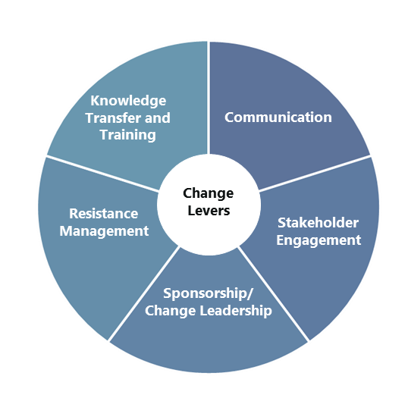
Change Management Considerations
Best Practices
Key considerations and "leading practices" have been provided below to support the development of the change management plan, once designed.
Communication – sharing information about the change and providing opportunities for stakeholders to discuss the information and ask questions. The purpose of communication is to:
  Answer people’s questions
  Build understanding about what is changing
  Alleviate fears and anxieties
  Create energy and enthusiasm for the change
  Recognize employees as partners in the change
  Mitigate unwanted conversation about the change
Stakeholder Engagement – bringing together individuals from a variety of positions across the organization to engage in collaborating on defining objectives for the change, assessing readiness for change, and sharing their experiences and learning with one another.
Sponsorship/ Change Leadership – during times of change, leaders are accountable for “living the change”, which means leading by example and holding oneself and others accountable for supporting the change. Leaders play an essential role in creating the conditions to help their staff understand change and successfully adapt.
Resistance Management – fostering an environment in which there is mutual trust and respect, and in which people feel comfortable with openly sharing their concerns, asking questions, and learning new knowledge and skills.
Knowledge Transfer and Training – ensuring that when the change is implemented, everyone has the knowledge they need to do things differently. Projects need to support knowledge transfer by providing people with effective training as well as resources like job aids and up-to-date policy and procedural documentation.

Slide 61
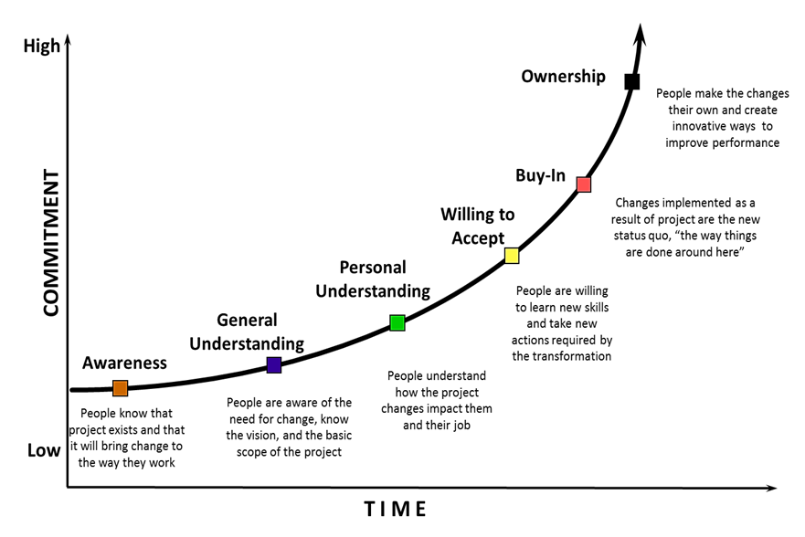
Change Commitment Curve
It is a model used to discuss the pace communication and engagement activities and can help understand the journey that people need to go through before they reach a level of willingness to accept or buy-in to a significant change.
The main concept of the curve is that getting to Buy-in and Ownership takes time and takes moving through several initial steps. It also is helping when determine the level of commitment a given stakeholder should reach as not everyone needs to reach ownership, some may just need to reach a willingness to accept.
Communication Objectives:
Move staff up the change curve (shown to the right);
Address concerns and / or questions raised by stakeholders; and
Maintain optimism and positive perception of the program to enable people to progress forward through the change journey.
Communication Good Practices:
Communication should be proactive and consistent;
Communicate frequently, but choose timing carefully;
Use two-way, in-person communications for important messages or if you anticipate questions; use email to convey information;
Solicit regular feedback to measure communications effectiveness; and
Leverage leaders to reinforce communications; make it easy for leaders by providing pre-written material and talking points to stay on message.

Slide 62
Risk Assessment
Risk and Mitigations
In the development of the implementation plan, the following assumptions were made:
The recommended organizational designs are approved;
Qualified candidates can be sourced to fill open positions;
Resources are available and made accountable to deploy the implementation plan activities; and,
An Implementation Team/Lead are established on schedule and the Senior Leadership is able to successfully develop an integrated project plan and manage the project effectively.
The overall success of Casselman's implementation can be affected by the following risks:
Risk | Mitigation
Employee resistance to change | Employ change management strategies to include employees in change activities and increase overall buy-in.
Shortfalls in resourcing | Plan resources in advance and gain approval from relevant stakeholders.
Delays in critical milestones | A selected Implementation Teams should conduct regular check-ins with an Implementation Lead or Steering Committee.
Shortfalls or complexity in Technology | This will be mitigated by the recommended technology assessment that will provide insights into solutions to increase process efficiency through the use of additional technology capabilities or further customizing the existing systems.

Slide 63
Appendices

Slide 64





Thank You
Jen hayes Engagement partner E: Jen.Hayes@mnp.ca T: 416.515.5055 111 Richmond St. W Suite #300 Toronto, ON M5H 2G4 |  | Jovette morin Project Manager E: Jovette.Morin@mnp.ca T: 705.523.0272 1970 Paris Street Sudbury, ON P3E 3C8

